Slide 1
CREATE CHATBOT IN PYTHON
PHASE FOUR: development part two

Slide 2
INTRODUCTION
What are Python AI chat bots? Python AI chat bots are essentially programs designed to simulate human-like conversation using Natural Language Process.
AI chat bots offer an effective platform for customers to reach out for assistance without waiting a long time. Customers can register their complaints, queries, and reviews with chatbots and they provide an immediate solution to their queries most of the timesing (NLP) and Machine Learning

Slide 3
THE ARCHITECTURE OF CHATBOT
Typical chatbot architecture should consist of the following:
Chat window/session/front end application interface
The deep learning model for Natural Language Processing [NLP]
Corpus or training data for training the NLP model
Application Database for processing actions to be performed by the chatbot
Please refer to the below figure to understand the architectural interface:

Slide 4
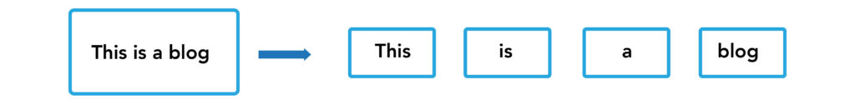
TOKENIZATIONA

Slide 5
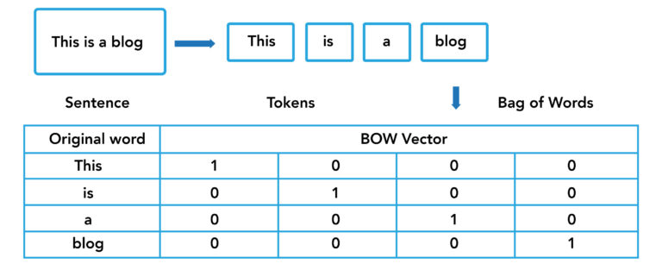
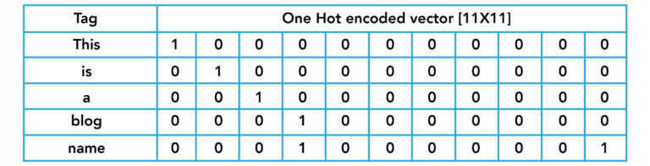

Slide 6
Algorithm for this text-based chatbot
Algorithm for this text-based chatbot
Input the corpus
Perform data pre-processing on corpus:
Text case [upper or lower] handling
Tokenization
Stemming
Generate BOW [Bag of Words]
Generate one hot encoding for the target column
Design a neural network to classify the words with TAGS as target outputs
Design a chat utility as a function to interact with the user till the user calls a “quit”
If the user does not understand or finds the bot’s answer irrelevant, the user calls a “*” asking the bot to re-evaluate what the user has asked
Run the chat utility function

Slide 7
FEATURE ENGINEERING
Feature engineering improves the performance of the machine learning model by selecting the right features for the model and preparing the features in a way that is suitable for the machine learning model. For example, if we would like to predict the price of a car, the target variable would be the Market Value.

Slide 8
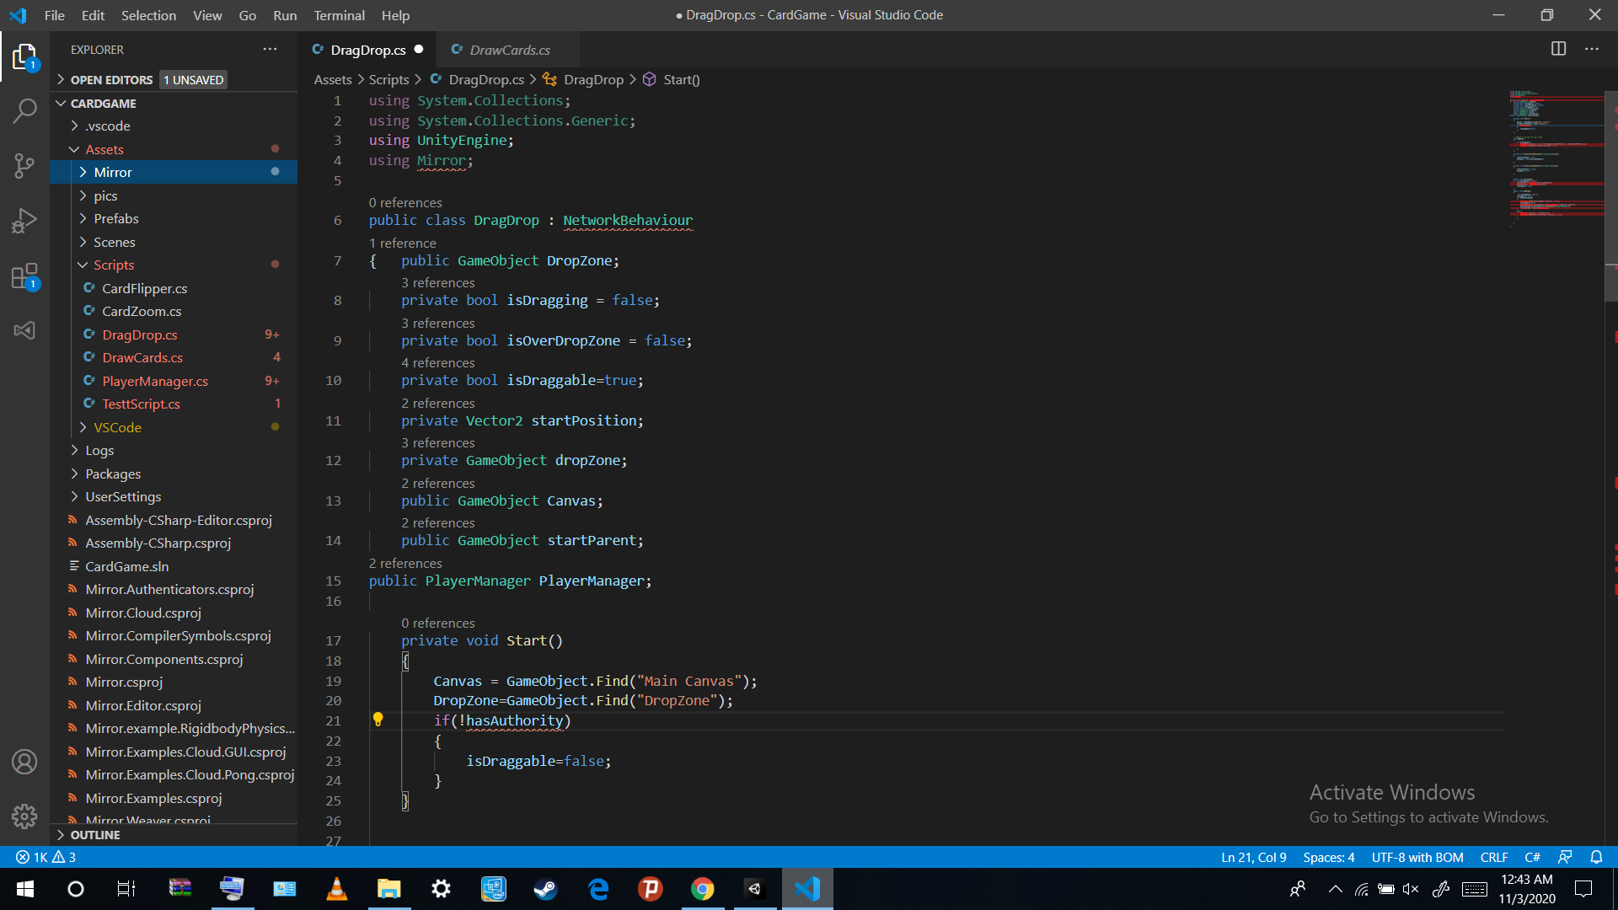

Slide 9
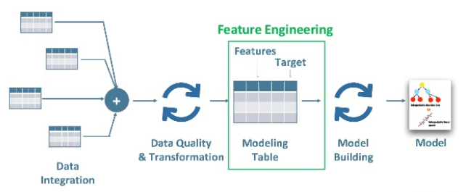

Slide 10
MODEL TRAINING
It is called Train/Test because you split the data set into two sets: a training set and a testing set. 80% for training, and 20% for testing. You train the model using the training set. You test the model using the testing set. Train the model means create the model.

Slide 11
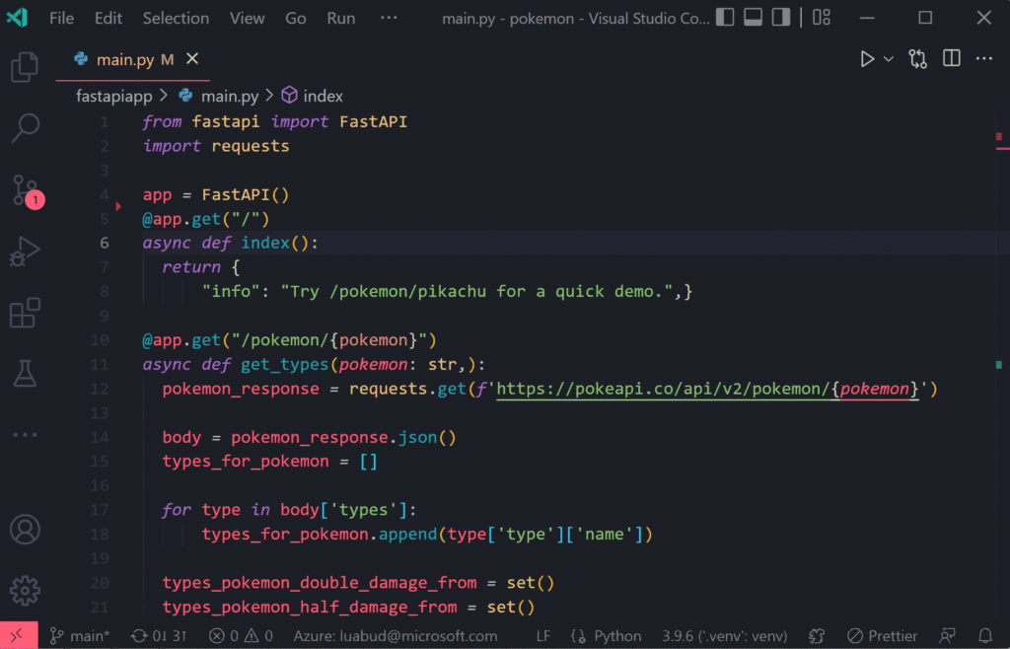

Slide 12
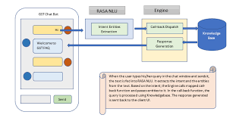

Slide 13
EVALUATION
Python's eval() allows you to evaluate arbitrary Python expressions from a string-based or compiled-code-based input. This function can be handy when you're trying to dynamically evaluate Python expressions from any input that comes as a string or a compiled code object.

Slide 14
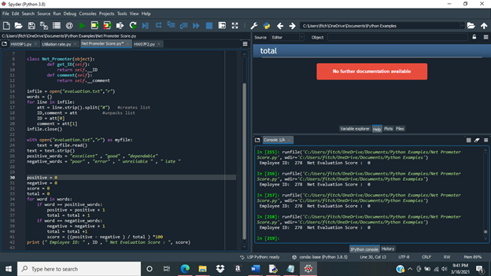

Slide 15
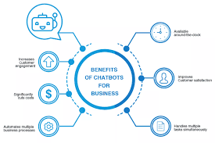

Slide 16
conclusions
A database is used in many applications for the connection of Chatbots.Every customer or user needs appropriate answers and so database is used to so that purpose can be solved. Human language can be transformed into the data transformation with the help of NLP. NLP helps to transform with a blend of text and patterns because of which it gets applicable responses. There are many NLP applications and programming interfaces and services that helps in development of Chatbots. And make it possible for all sort of businesses – small, medium or large-scale industries. The primary point here is that smart bots can help increase the customer base by enhancing the customer support

